Slide 1
Monopoly (Part 2)
Chapter 21

Slide 2
Price and Output for a Profit-Maximizing Monopolist
Profit Maximizing Condition: MR = MC
The monopolist that seeks to maximize profits produces the quantity of output at which MR=MC and charges the highest price per unit at which this quantity of output can be sold.
A monopolists can also make profits and loses, after taking into consideration Average Total Costs.
A monopolist can occur a loss if the highest possible price charged at MR = MC is less than the ATC at that point

Slide 3
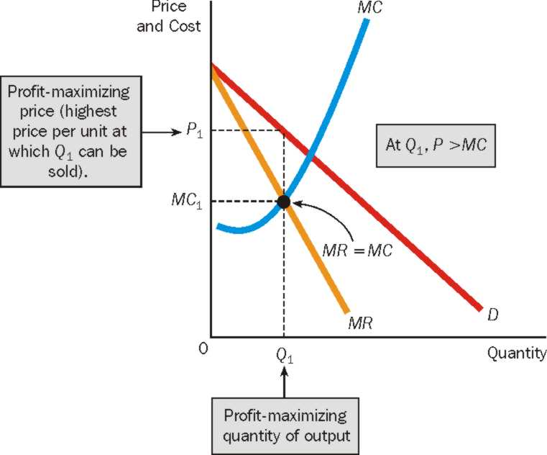
The Monopolist’s Profit-Maximizing Price and Quantity of Output
The monopolist produces the quantity of output (Q₁) at which MR=MC, and charges the highest price per unit at which the quantity of output can be sold (P₁). Notice that at the profit maximizing quantity of output, price is greater than marginal cost, P>MC.

Slide 4
If a Firm Maximizes Revenue, Does it Automatically Maximize Profit Too?
Given TR = $100, TFC = $40, TVC = $20. What is the profit?
Let one more unit of good is produced. TR increases to $105, TFC = $40, TVC = $30. What is the profit?
Has profit risen or fallen?
Let one more unit of good is produced. TR increases to $105, TFC = $40, TVC = 0 [in both cases]. What is the profit?
Conclusion: Maximizing revenues is the same as maximizing profits only when a firm has no variable costs. It is unlikely, though, that a firm will be without variable costs.

Slide 5
Perfect Competition and Monopoly
For the perfectly competitive firm, P=MR; for the monopolist, P>MR. The perfectly competitive firm’s demand curve is its marginal revenue curve; the monopolist’s demand curve lies above its marginal revenue curve
The perfectly competitive firm charges a price equal to marginal cost; the monopolist charges a price greater than marginal cost.
A monopoly firm differs from a perfectly competitive firm in terms of how much consumers’ surplus buyers receive.

Slide 6
Monopoly, Perfect Competition, and Consumers’ Surplus
For Perfectly Competitive Firm:
Demand Curve = MR
Profit Maximizing at MR = MC
Demand Curve = MC: Price = MC.
Consumer Surplus: PpcBA
For Monopolist:
Demand Curve > MR
Profit Maximizing at MR = MC
Price > MC.
Consumer Surplus: PmAC

Slide 7
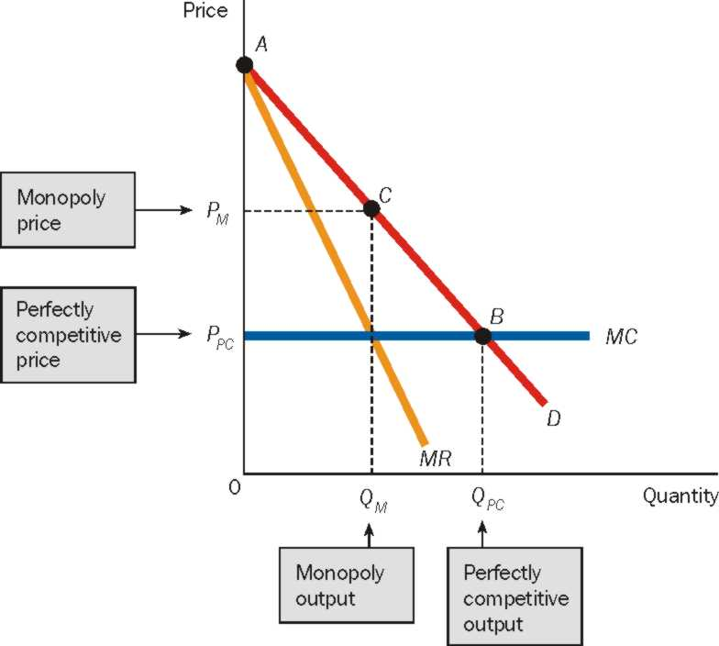
Monopoly, Perfect Competition, and Consumers’ Surplus
Would you, as a consumer prefer a monopoly or a perfectively competitive market?

Slide 8
Monopoly or Nothing?
Answer: Perfect Competition.
Lower prices
More Output
Higher Consumer Surplus.
But, what if the option of Perfect Competition is not available?
In Perfect Competition 🡺 many sellers 🡺 each producing less output 🡺 cannot produce at lowest possible cost 🡺 producing at a higher MC and ATC
In Monopoly 🡺 single seller 🡺 producing entire industry output 🡺 can achieve Economies of scale 🡺 produce at lowest possible cost.

Slide 9
The Case Against Monopoly: Deadweight Loss
The Deadweight Loss of Monopoly: Greater output is produced under perfect competition than under monopoly. The net value of the difference in these two output levels is said to be the deadweight loss of monopoly. This is the amount buyers value the additional output over and above the opportunity costs of producing the additional output.
The difference in output results in a welfare loss to the society.

Slide 10
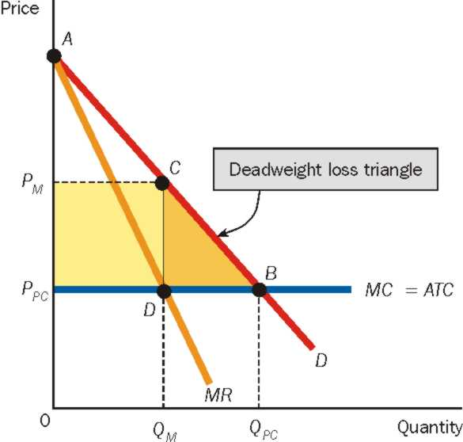
The Case Against Monopoly: Deadweight Loss
The monopolist produces Q_{M}, and the perfectly competitive firm produces the higher output level Q_{PC}
Moving from Q_{M} to Q_{PC}:
Value to Buyers of additional output = Q_{M}CB Q_{PC}
Cost to Seller to produce additional output = Q_{M}DB Q_{PC}
Deadweight loss = Q_{M}CB Q_{PC} - Q_{M}DB Q_{PC} = ∆DBC

Slide 11
Rent Seeking
Rent Seeking: If firm A tries to get the government to transfer “income” or consumers’ surplus from buyers to itself it is undertaking a transfer seeking activity. In economics, these activities are usually called Rent Seeking.
Rent seeking is a socially wasteful activity because resources are expended to affect a transfer and not to produce goods and services.

Slide 12
Rent Seeking
The monopolist produces Q_{M}, and the perfectly competitive firm produces the higher output level Q_{PC}
Moving from Q_{M} to Q_{PC}:
Profit of the monopolist = P_{M}CD P_{PC.}
Consumer Surplus if Perfectly Competitive Firms = ABP_{PC}
Consumer Surplus if Monopolist = ACP_{M}
Loss in Consumer Surplus = ABP_{PC} – ACP_{M} = P_{M}CB P_{PC.}
This includes P_{M}CD P_{PC.}
Part of Consumer surplus is converted to monopolist’s profit

Slide 13
Conditions of Price Discrimination
Price discrimination is the business practice of selling the same good at different prices to different buyers. Price discrimination occurs when the seller charges different prices for the product it sells, and the price differences do not reflect costs.
Conditions of Price Discrimination:
The seller must exercise some control over price; it must be a price searcher.
The seller must be able to distinguish among buyers who would be willing to pay different prices.
It must be impossible or too costly for one buyer to resell the good at other buyers. The possibility of arbitrage, or “buying low and selling high” must not exist.

Slide 14
Price Discrimination
Perfect Price Discrimination: sells each unit separately and charges the highest price each consumer would be willing to pay for the product.
For the monopolist who practices perfect price discrimination, price equals marginal revenue (because even if you charge a price higher for one person, you need not reduce the price for another person). So, P = MR = MC (allocative efficiency).
One of the uses of the cents-off coupon is to make it possible for the seller to charge a higher price to one group of customers than to another group.
Second Degree Discrimination: it charges a uniform price per unit for one specific quantity, a lower price for an additional quantity, and so on.
Third Degree Discrimination: it charges a different price in different markets or charges a different price to different segments of the buying population.
Notes:
Cents-off coupon. People who place less value on time will bother collecting coupons and availing a low price, while people who place less value on time will NOT bother collecting coupons and hence pay a high price.

